Slide 1

Mint Classics Database Analysis and Optimization
Mahmoud Alsaleh
June 2024

Slide 2
Introduction
This project aims to analyze and optimize the inventory management of Mint Classics Company by investigating the potential closure of one of its storage facilities. The project involves importing, understanding, and analyzing the Mint Classics relational database using MySQL Workbench. The analysis will lead to data-driven recommendations to improve business processes.

Slide 3
Data Overview
This project focuses on analyzing the Mint Classics Company's relational database, which includes comprehensive data on product inventory, sales, and storage locations. The dataset was provided by the company to assist in making data-driven decisions about inventory management, to close one of their storage facilities. By delving into this data, we aimed to uncover insights that would guide the reorganization or reduction of inventory while maintaining efficient customer service. Our analysis targeted key aspects such as inventory distribution, sales performance, and product movement to form a solid foundation for our recommendations.

Slide 4
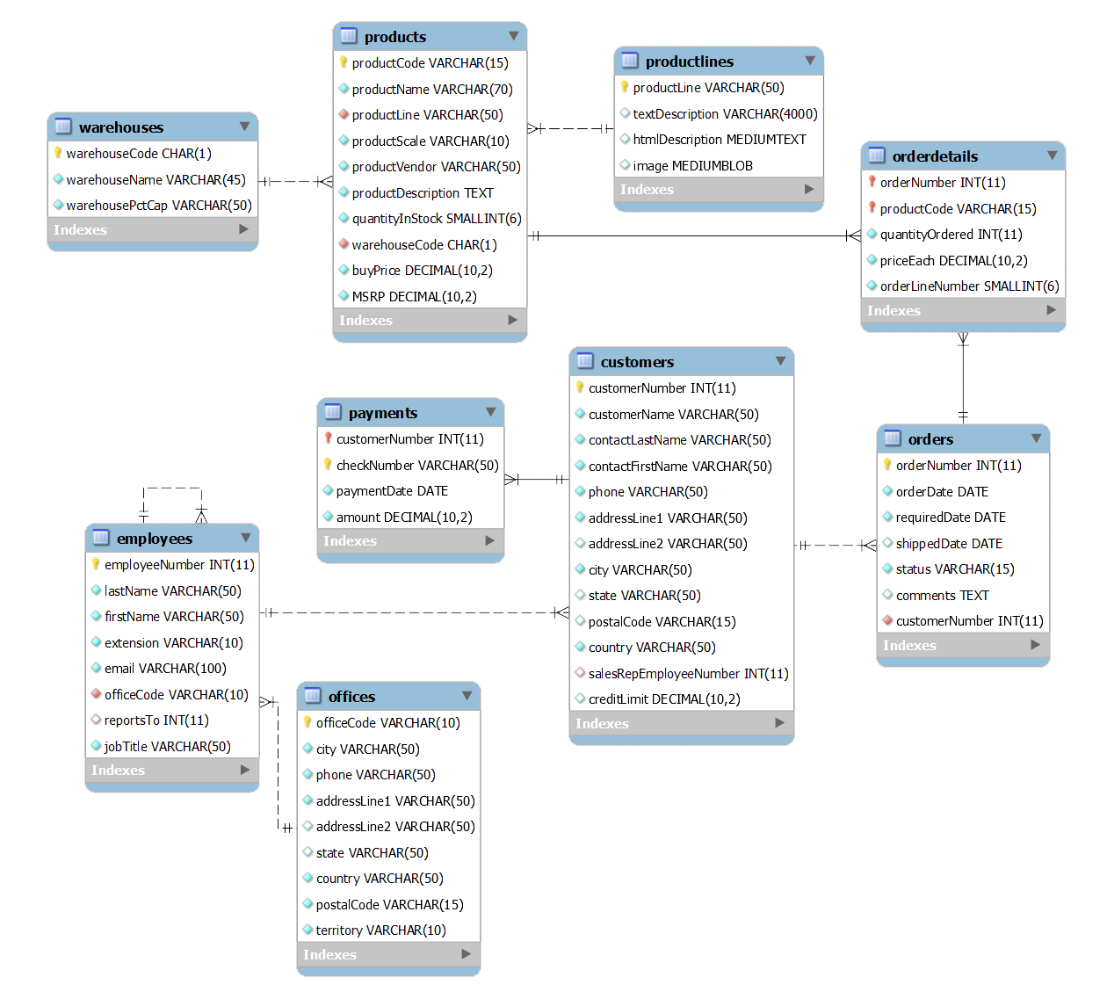
Database Diagram

Slide 5
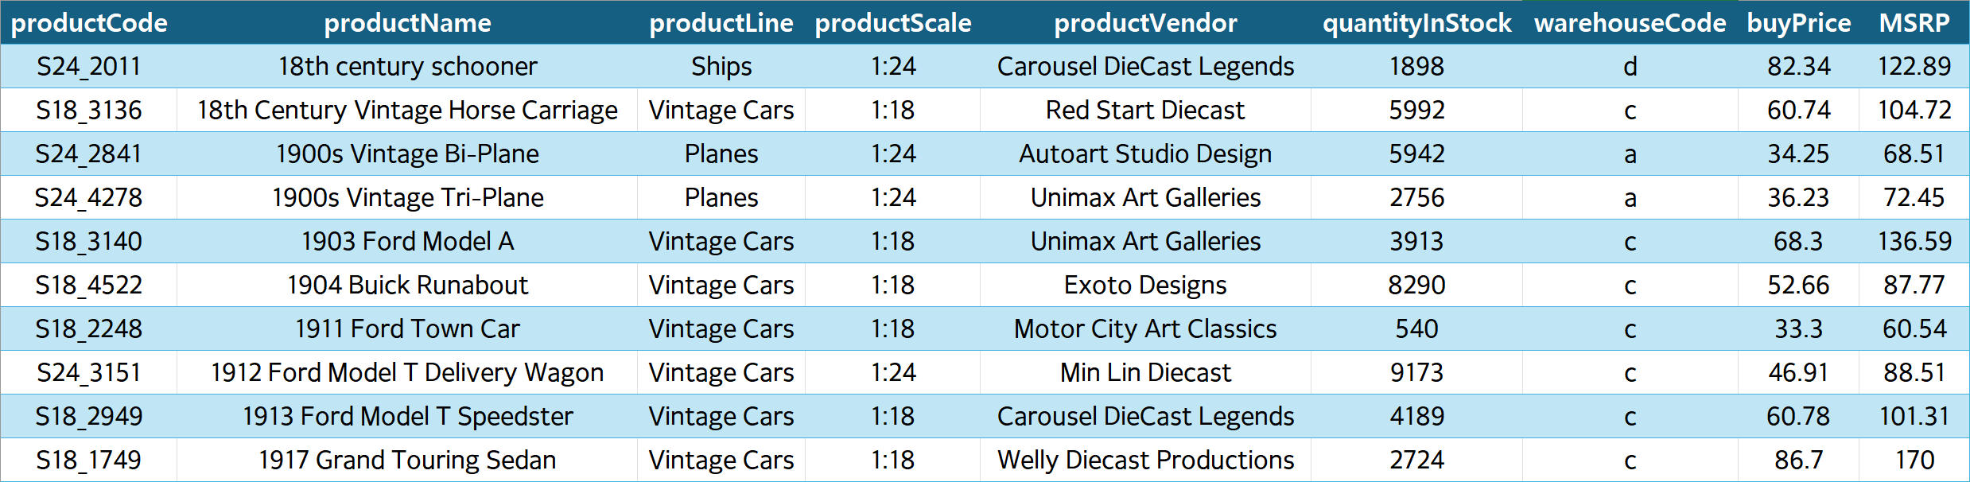
Products
The Products table contains details about each product available in the Mint Classics Company's inventory, including product codes, names, scales, and prices. This information is crucial for identifying the variety of items stored and sold by the company.

Slide 6
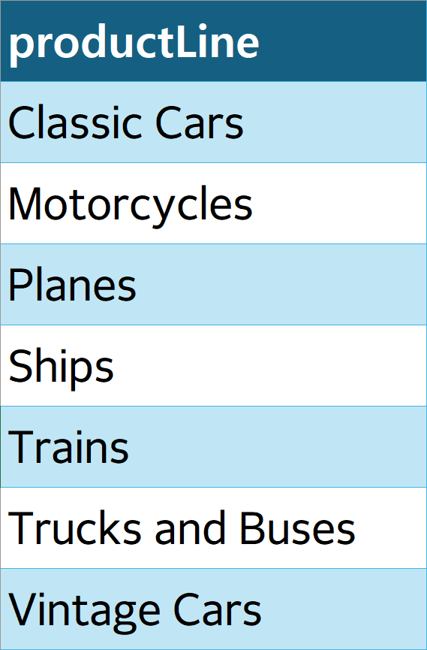
Product Lines
The ProductLine table categorizes products into different lines or themes, providing a structured way to group related items. This helps in understanding the breadth and focus of the company's product offerings.

Slide 7
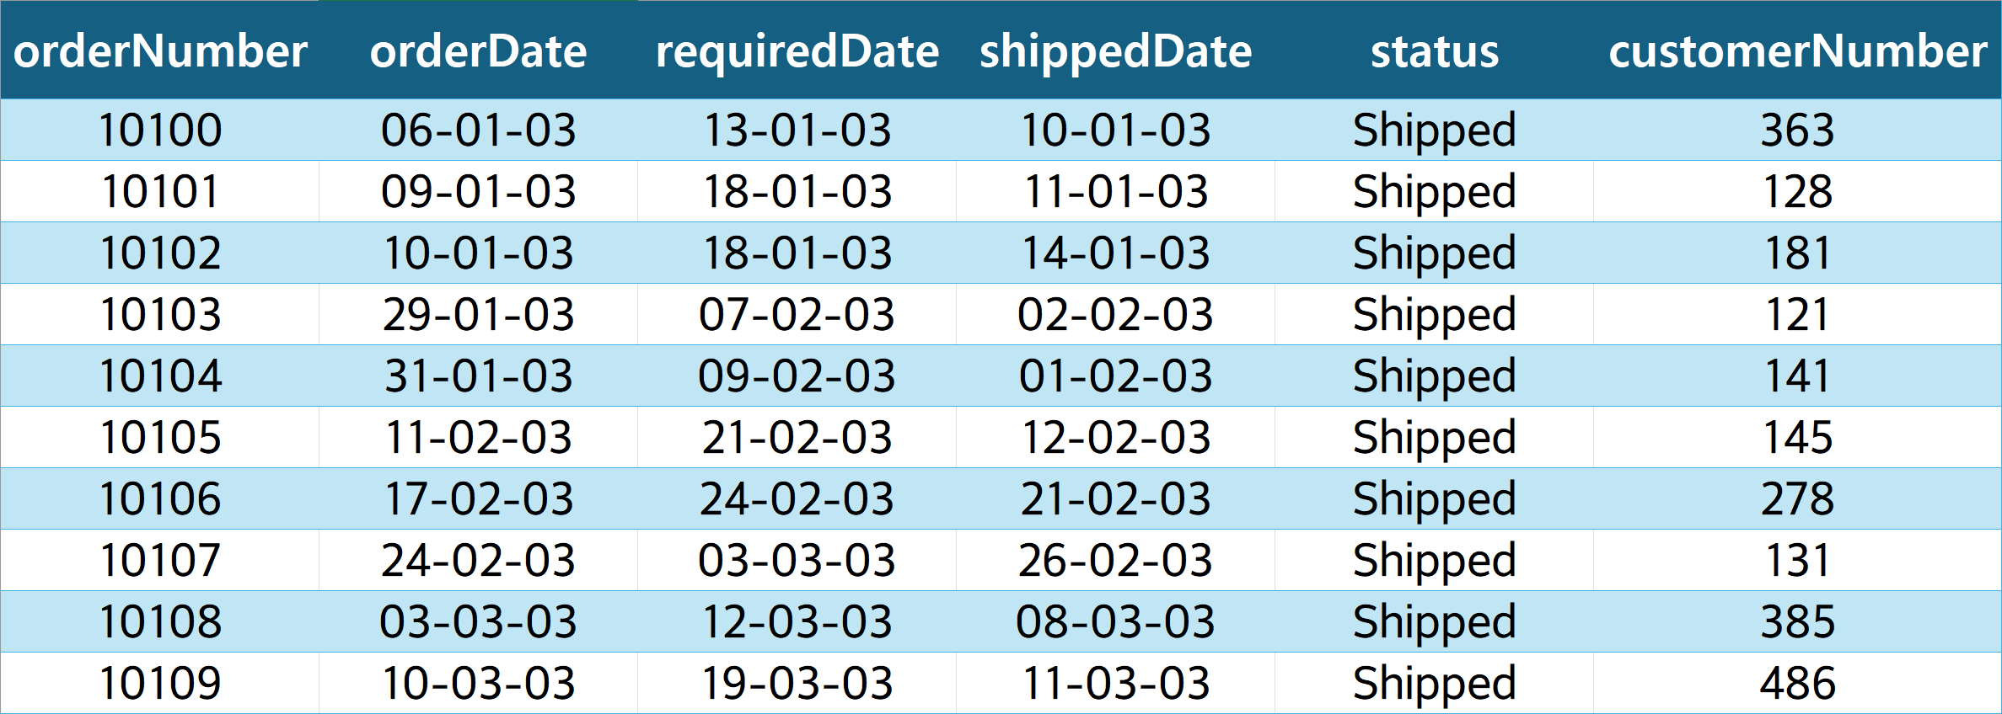
Orders
The Orders table records each customer order, including the order number, order date, and status. This data is essential for tracking sales and understanding customer demand over time.

Slide 8
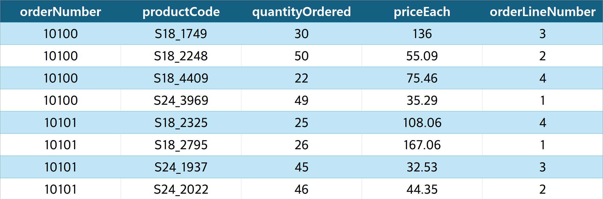
Order Details
The OrderDetails table breaks down each order into specific items purchased, including quantities and prices. This granularity allows for a detailed analysis of sales and inventory movement at the product level.

Slide 9
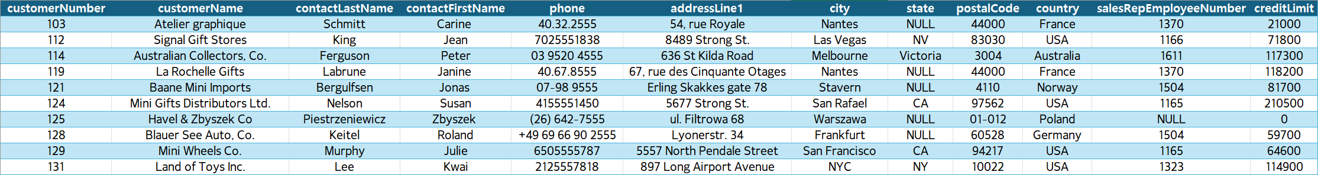
Customer Table
The Customers table holds information about the company's customers, including contact details and credit limits. This table is key to understanding the customer base and their purchasing behaviors.

Slide 10
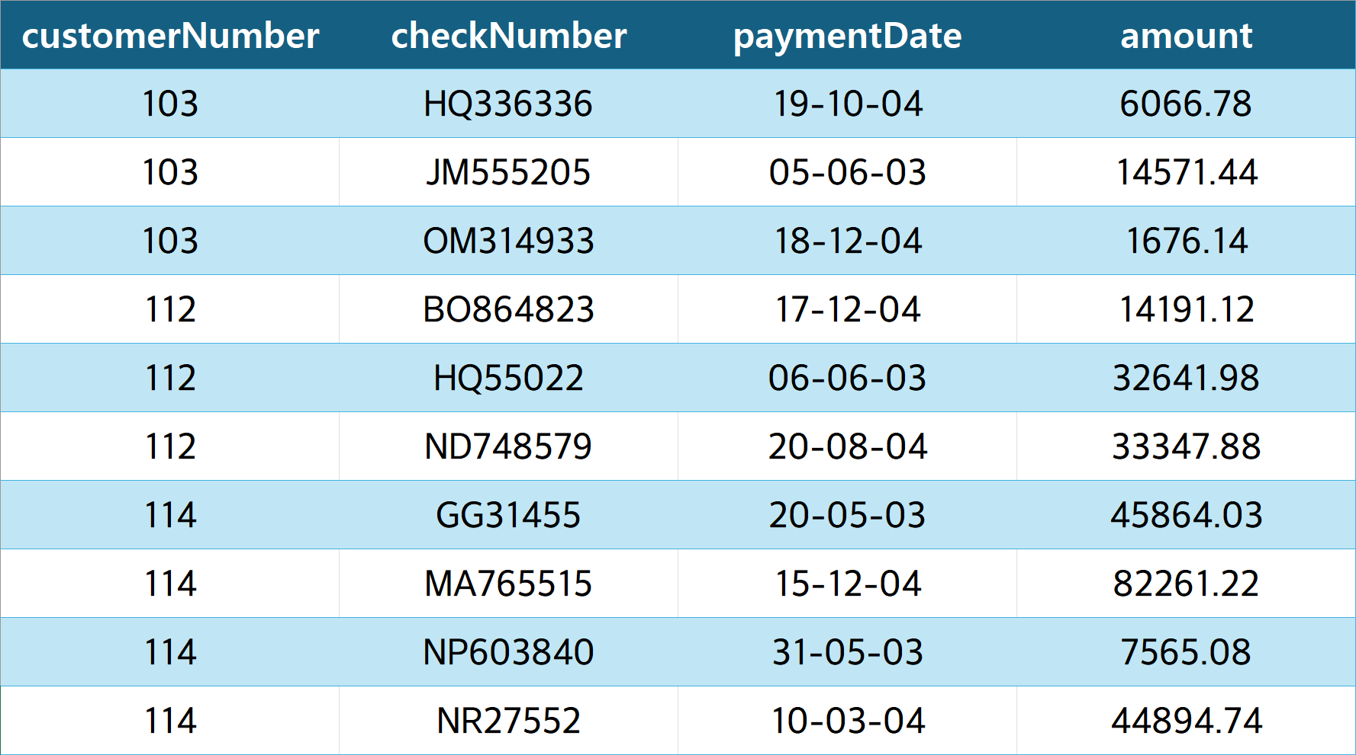
Payments
The Payments table documents payment transactions made by customers, including payment dates and amounts. This data is important for financial analysis and ensuring timely payment processing.

Slide 11
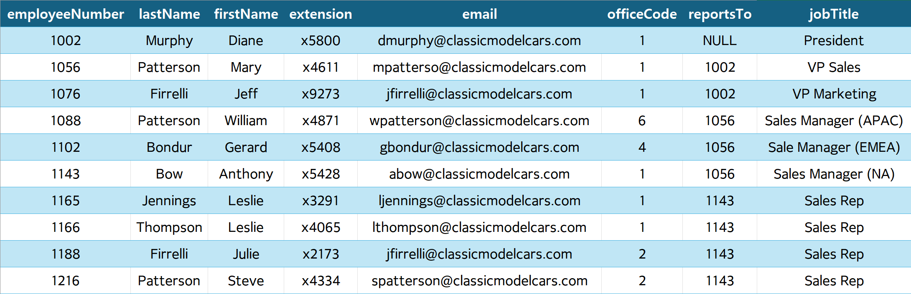
Employees
The Employees table lists information about the company's employees, including job titles, office locations, and supervisors. This table helps in analyzing the human resources aspect of the business.

Slide 12
Offices
The Offices table provides details about the company’s office locations, including addresses and contact information. This data supports logistical and operational planning.

Slide 13
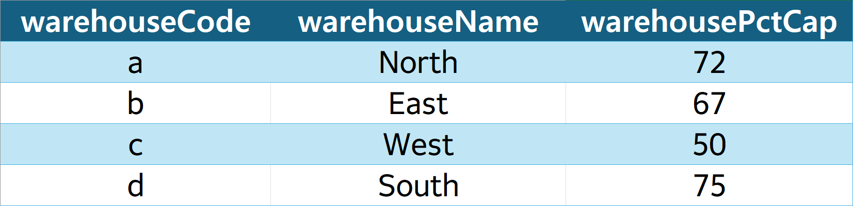
Warehouses
The Warehouses table details the storage facilities, including warehouse names and capacities as percentages. This table is crucial for analyzing inventory distribution across different facilities and identifying opportunities for consolidation or reduction.

Slide 14

Database Explore

Slide 15
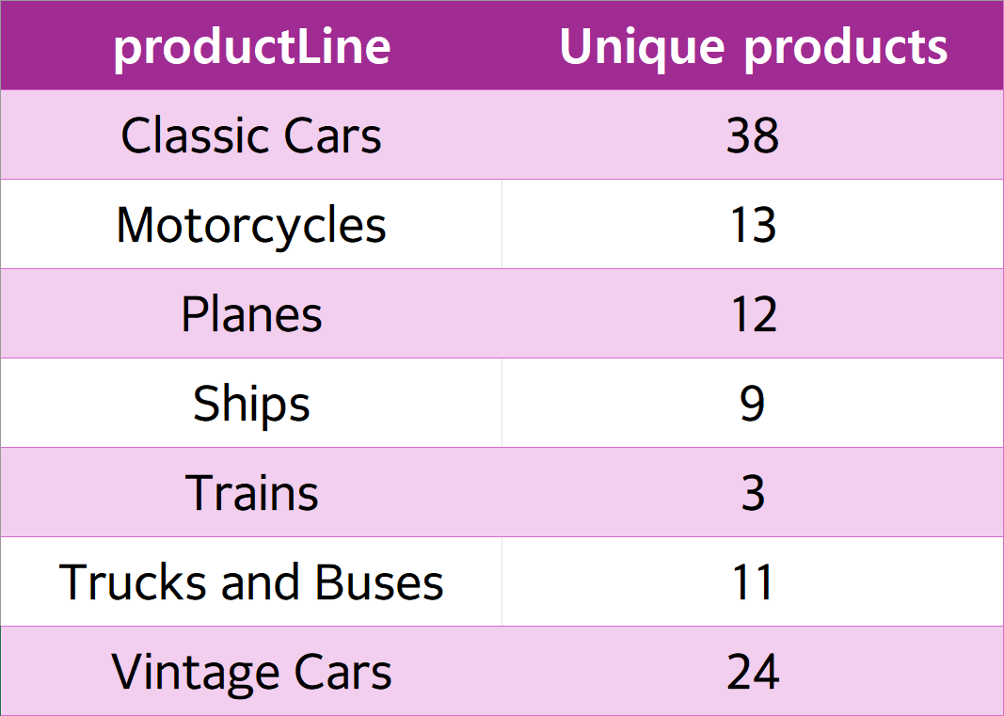
Unique Products in Each Product Line
Select productLine,
count(*) AS 'Unique products’
From mintclassics.products
group by productLine;

Slide 16
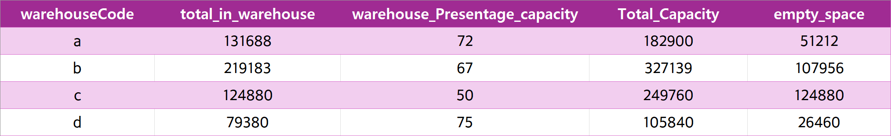
Total Capacity for each warehouse
SELECT p.warehouseCode, SUM(p.quantityInStock) AS total_in_warehouse,
w.warehousePctCap AS warehouse_Presentage_capacity,
ROUND((SUM(p.quantityInStock) / w.warehousePctCap) * 100, 0) AS Total_Capacity
FROM mintclassics.products p
join mintclassics.warehouses w
ON p.warehouseCode = w.warehouseCode
GROUP BY warehouseCode

Slide 17
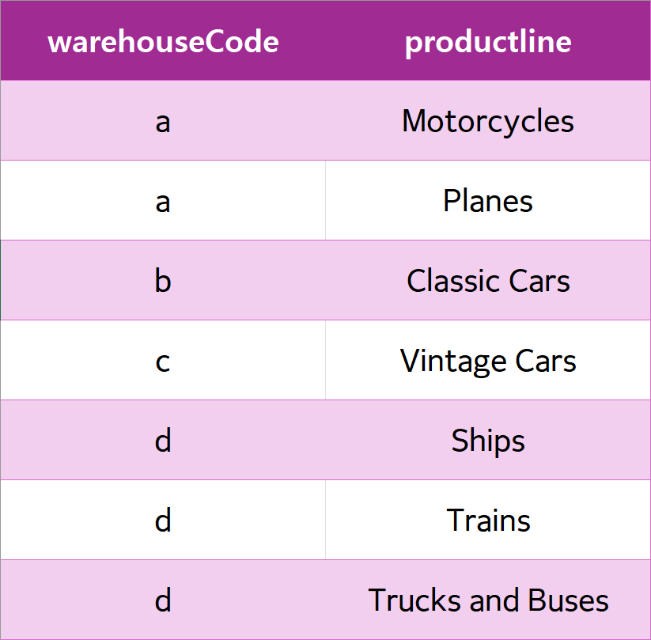
Production lines distribution in warehouses
SELECT warehouseCode, productline
FROM mintclassics.products
Group by productline
ORDER BY warehouseCode

Slide 18
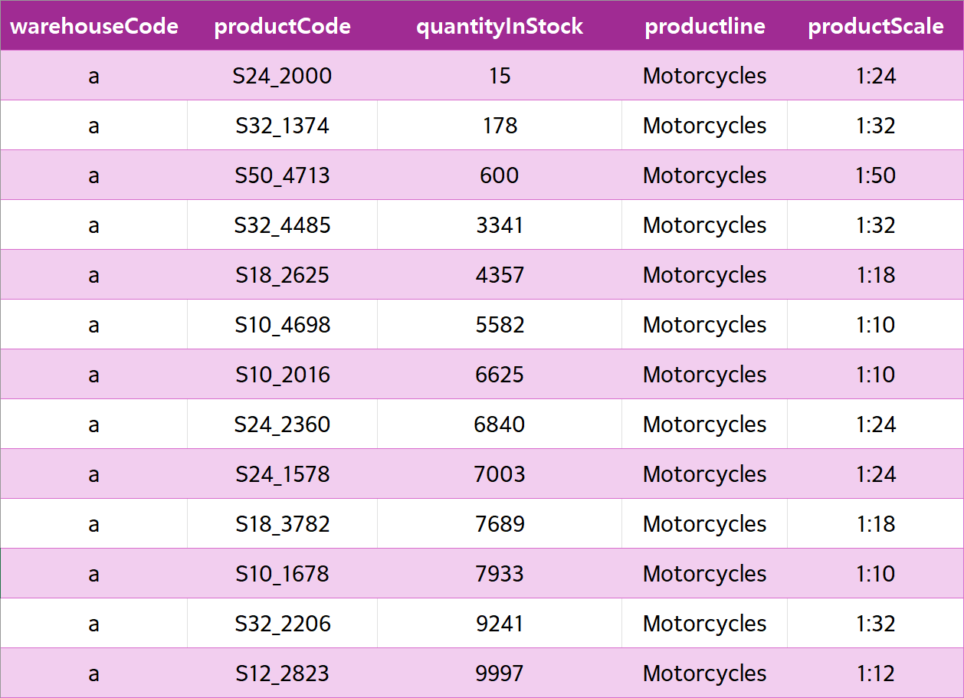
Motorcycle Products
SELECT warehouseCode, productCode, quantityInStock, productline
FROM mintclassics.products
WHERE warehouseCode = "a" AND productLine = 'Motorcycles’
ORDER BY quantityInStock;
* Warehouse (a) has 13 unique Motorcycle items and a total of 69401 Motorcycles.

Slide 19
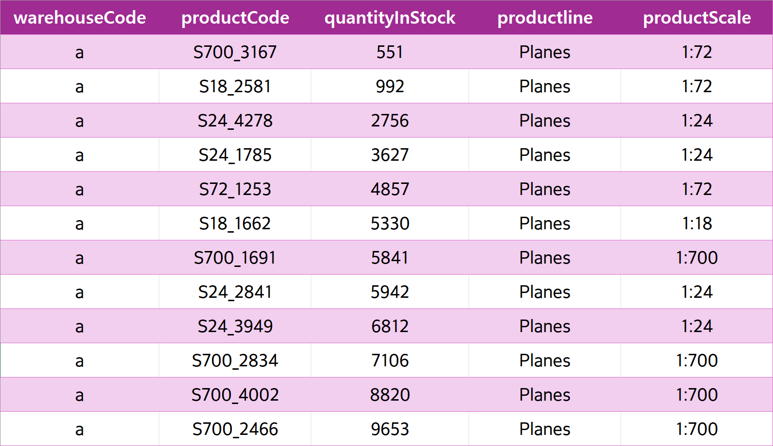
Plane Products
SELECT warehouseCode, productCode, quantityInStock, productline
FROM mintclassics.products
WHERE warehouseCode = "a" AND productLine = Planes’
ORDER BY quantityInStock;
* Warehouse (a) has 12 unique Plane items and a total of 62287 Planes.

Slide 20

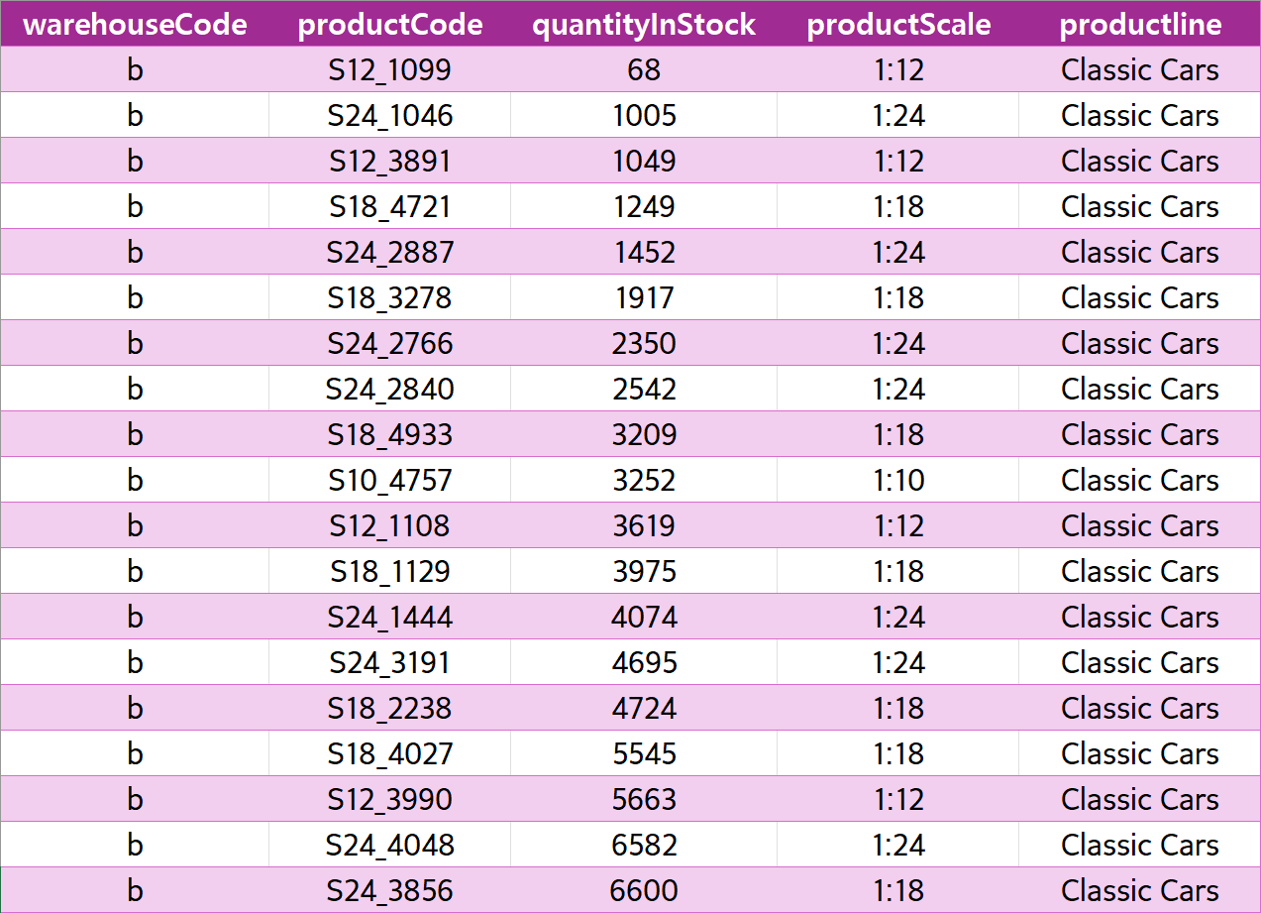
Classic Car Products (1/2)
SELECT warehouseCode, productCode, quantityInStock, productline
FROM mintclassics.products
WHERE warehouseCode = “b”
ORDER BY quantityInStock;
* Warehouse (b) has only Classic Cars and it has 38 unique car items and a total of 219183 cars.

Slide 21
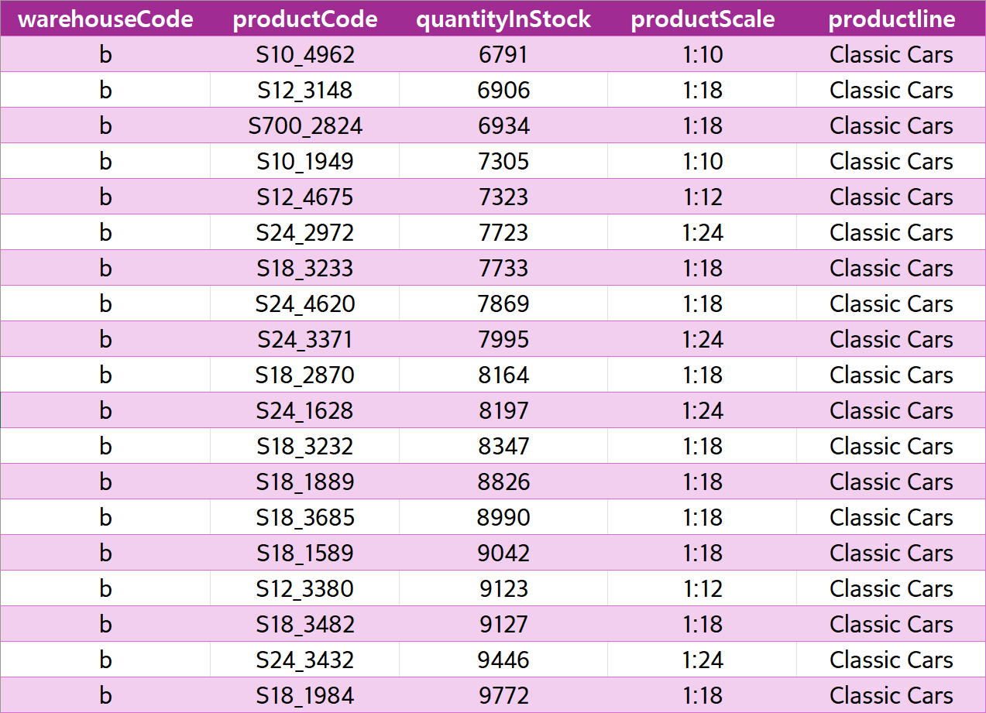
Classic Car Products (2/2)
SELECT warehouseCode, productCode, quantityInStock, productline
FROM mintclassics.products
WHERE warehouseCode = “b”
ORDER BY quantityInStock;
* Warehouse (b) has only Classic Cars and it has 38 unique car items and a total of 219183 cars.

Slide 22
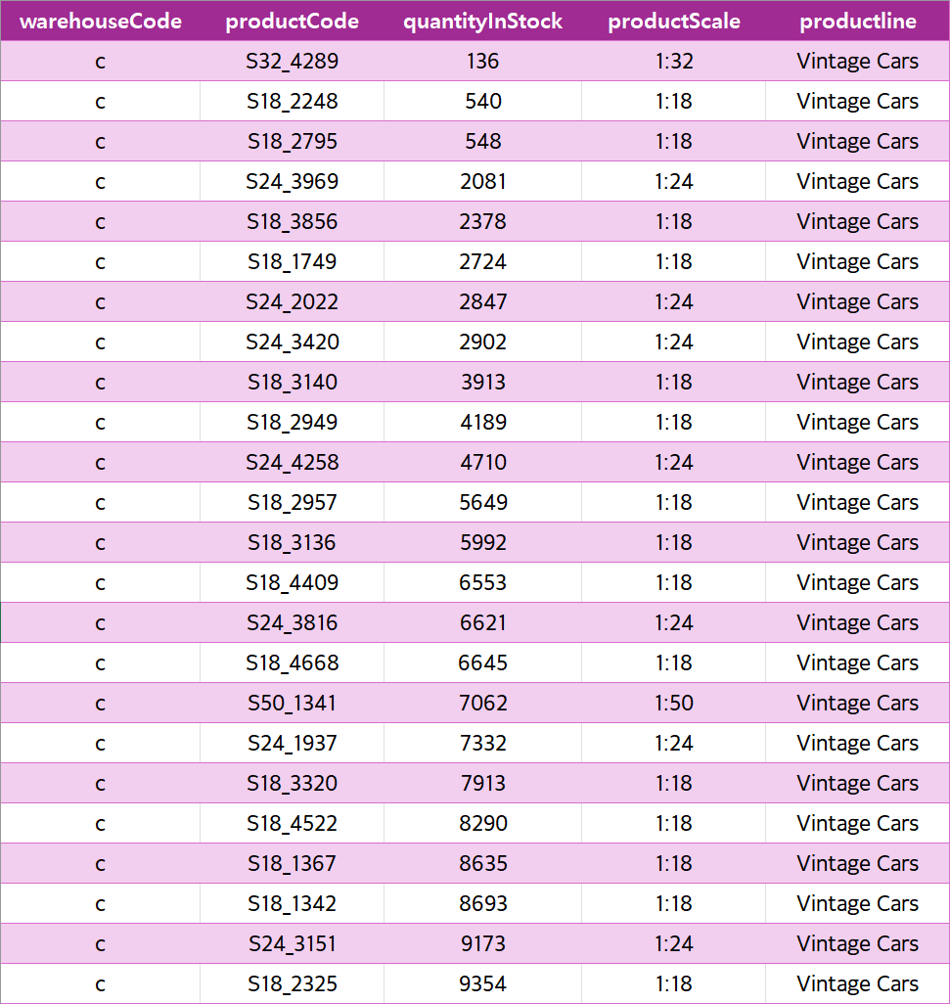
Vintage Car Products
SELECT warehouseCode, productCode, quantityInStock, productline
FROM mintclassics.products
WHERE warehouseCode = “c”
ORDER BY quantityInStock;
* Warehouse (c) has only Vintage Cars and it has 24 unique car items and a total of 124880 cars.

Slide 23
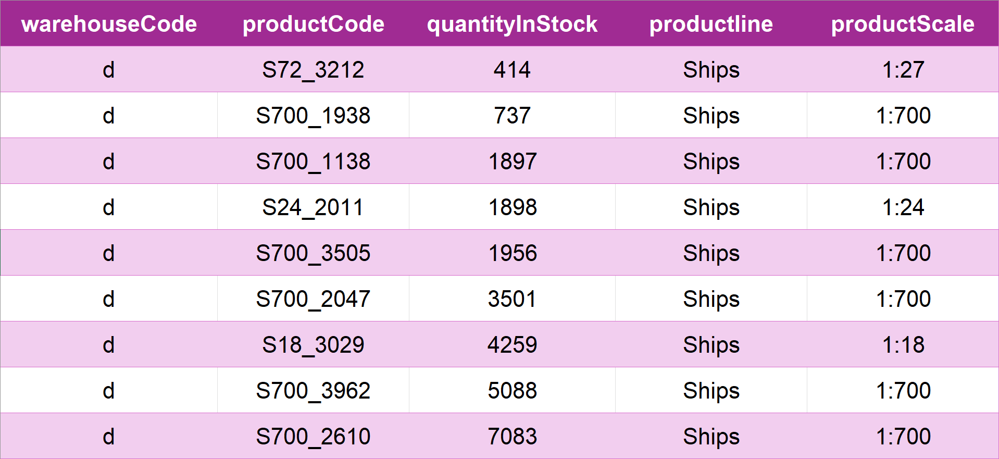
Ship Products
SELECT warehouseCode, productCode, quantityInStock, productline
FROM mintclassics.products
WHERE warehouseCode = “d” AND productline = 'Ships'
ORDER BY quantityInStock;
* Warehouse (d) has 9 unique Ship items and a total of 26833 Ships.

Slide 24
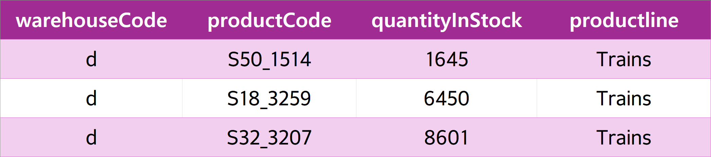
Train Products
SELECT warehouseCode, productCode, quantityInStock, productline
FROM mintclassics.products
WHERE warehouseCode = “d” AND productline = ‘Trains'
ORDER BY quantityInStock;
* Warehouse (d) has 3 unique Train items and a total of 16696 Trains.

Slide 25
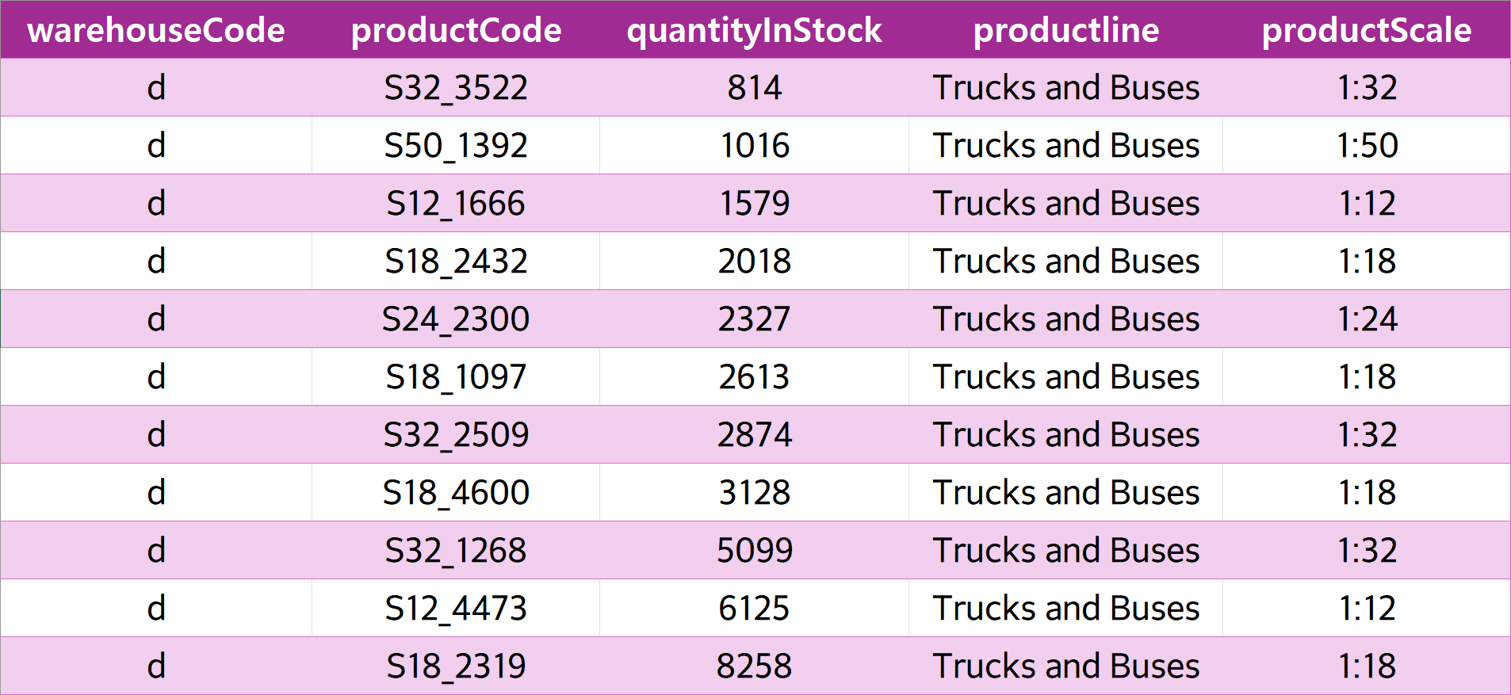
Truck & Bus Products
SELECT warehouseCode, productCode, quantityInStock, productline
FROM mintclassics.products
WHERE warehouseCode = “d” AND productline = ‘Truck and Buses'
ORDER BY quantityInStock;
* Warehouse (d) has 11 unique Truck and bus items and a total of 35851 Trucks and Buses.

Slide 26
Revenue
SELECT sub.productCode, p.productName, sub.avgSellPrice AS sellPrice, p.buyPrice, sub.totalSold, (sub.avgSellPrice - p.buyPrice) * sub.totalSold AS revenue
FROM(
SELECT od.productCode,
AVG(od.priceEach) AS avgSellPrice,
SUM(od.quantityOrdered) AS totalSold
FROM mintclassics.orderdetails od
JOIN mintclassics.orders o
ON od.orderNumber = o.orderNumber
WHERE o.status IN ('Shipped', 'Resolved’)
GROUP BY od.productCode
) AS sub
JOIN mintclassics.products p ON sub.productCode = p.productCode
ORDER BY revenue DESC;

Slide 27
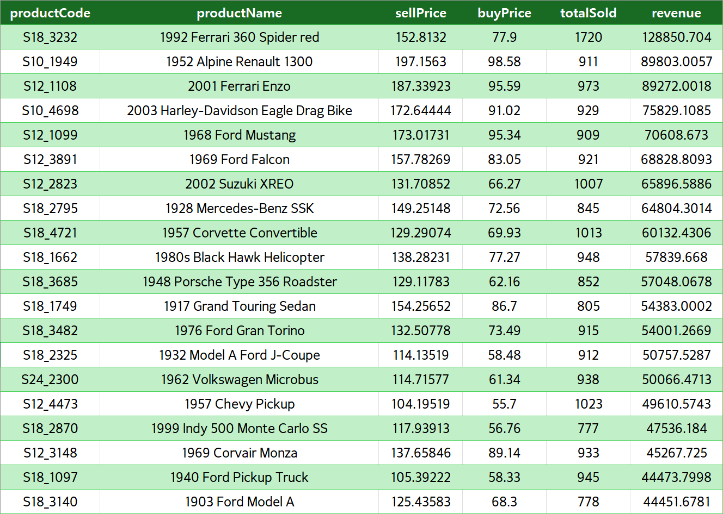
Top 20

Slide 28
Monthly Average Revenue
WITH TotalSales AS (
SELECT p.productCode, p.productName, p.warehouseCode, p.quantityInStock, od.priceEach,
COALESCE(SUM(od.quantityOrdered), 0) AS total_ordered_item,
COALESCE(SUM(od.quantityOrdered * od.priceEach), 0) AS total_revenue
FROM mintclassics.products p
LEFT JOIN mintclassics.orderdetails od ON p.productCode = od.productCode
LEFT JOIN mintclassics.orders o ON od.orderNumber = o.orderNumber AND o.status IN ('Shipped', 'Resolved')
GROUP BY p.productCode, p.warehouseCode, p.quantityInStock
)
SELECT ts.productCode, ts.productName, ts.warehouseCode, ts.quantityInStock, ts.total_ordered_item, ts.total_revenue,
ROUND(ts.total_ordered_item / 18, 0) AS avg_monthly_sales, -- Assuming 18-month period for average sales calculation
ROUND(ts.priceEach * (ts.total_ordered_item / 18)) AS avg_monthly_revenue -- Assuming 18-month period for average revenue calculation
FROM TotalSales ts
ORDER BY avg_monthly_revenue DESC
LIMIT 20

Slide 29
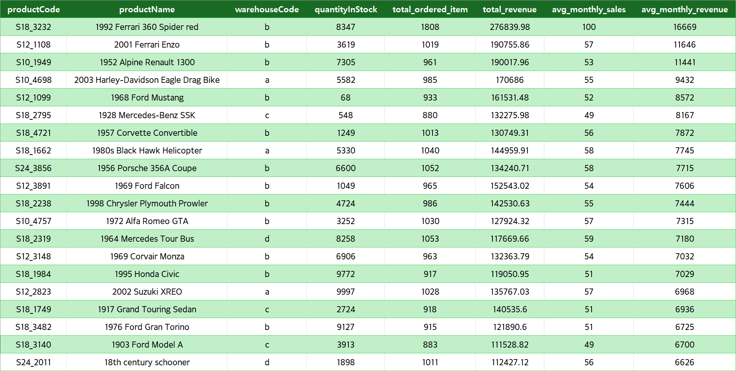
Top 20

Slide 30
Never ordered Items
SELECT p.productCode, p.warehouseCode, p.quantityInStock,
COALESCE(SUM(CASE WHEN o.status IN ('Shipped', 'Resolved’)
THEN od.quantityOrdered ELSE 0 END), 0) AS total_ordered_item
FROM mintclassics.products p
LEFT JOIN mintclassics.orderdetails od ON p.productCode = od.productCode
LEFT JOIN mintclassics.orders o ON od.orderNumber = o.orderNumber
GROUP BY p.productCode, p.warehouseCode, p.quantityInStock
HAVING total_ordered_item < 1
ORDER BY p.warehouseCode;

Slide 31

Recommendations and Action Plan

Slide 32
Good Stock level (Using Old sales)
WITH TotalSales AS (
SELECT p.productCode, p.warehouseCode, p.quantityInStock,
COALESCE(SUM(od.quantityOrdered), 0) AS total_ordered_item
FROM mintclassics.products p
LEFT JOIN mintclassics.orderdetails od ON p.productCode = od.productCode
LEFT JOIN mintclassics.orders o ON od.orderNumber = o.orderNumber AND o.status IN ('Shipped', 'Resolved’)
GROUP BY p.productCode, p.warehouseCode, p.quantityInStock
)
SELECT ts.productCode, ts.warehouseCode, ts.quantityInStock,ts.total_ordered_item,
ROUND(ts.total_ordered_item / 18, 0) AS avg_monthly_sales, -- 18-month period for average sales calculation
ROUND((ts.total_ordered_item / 18) * 12, 0) AS good_stock_level -- Assuming 12 months buffer for good stock level
FROM TotalSales ts
ORDER BY ROUND((ts.total_ordered_item / 18) * 12, 0)

Slide 33
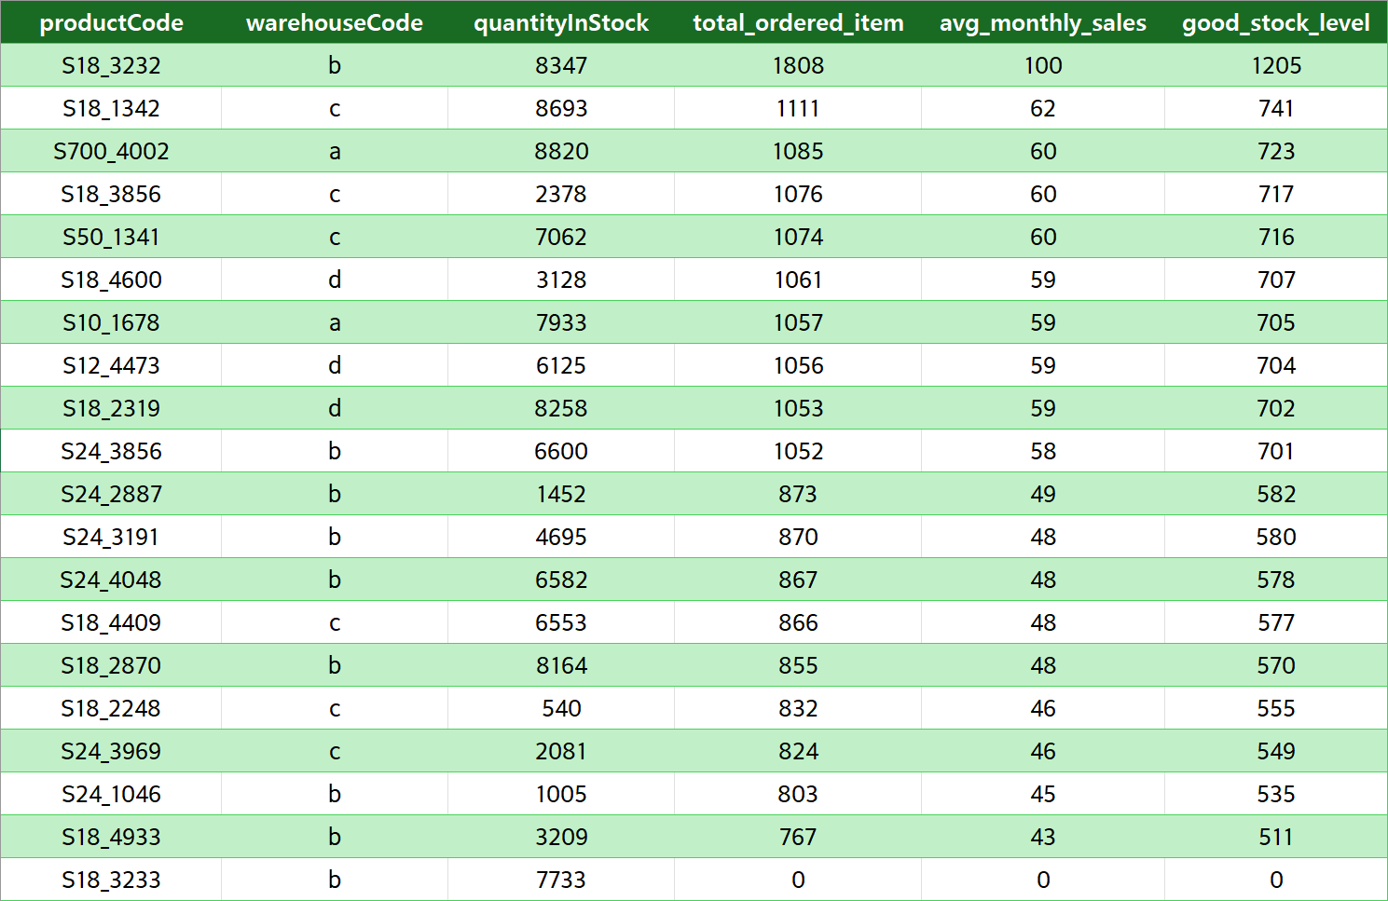
Top 10 and Last 10

Slide 34

Overstocked A Warehouse
WITH TotalSales AS (
SELECT p.productCode, p.warehouseCode, p.quantityInStock,
COALESCE(SUM(od.quantityOrdered), 0) AS total_ordered_item
FROM mintclassics.products p
LEFT JOIN mintclassics.orderdetails od ON p.productCode = od.productCode
LEFT JOIN mintclassics.orders o ON od.orderNumber = o.orderNumber AND o.status IN ('Shipped', 'Resolved’)
GROUP BY p.productCode, p.warehouseCode, p.quantityInStock
)
SELECT ts.productCode, ts.warehouseCode, ts.quantityInStock, ts.total_ordered_item,
ROUND(ts.total_ordered_item / 18, 0) AS avg_monthly_sales, -- 18-month period for average sales calculation
ROUND((ts.total_ordered_item / 18) * 12, 0) AS good_stock_level, -- Assuming 12 months buffer for good stock level
CASE
WHEN ts.total_ordered_item < 1 OR ts.quantityInStock > (ts.total_ordered_item / 18) * 12 THEN 'Overstocked’
END AS inventory_status
FROM TotalSales ts
WHERE ts.quantityInStock > (ts.total_ordered_item / 18) * 12 AND ts.warehouseCode = 'a’
ORDER BY ts.warehouseCode, good_stock_level

Slide 35
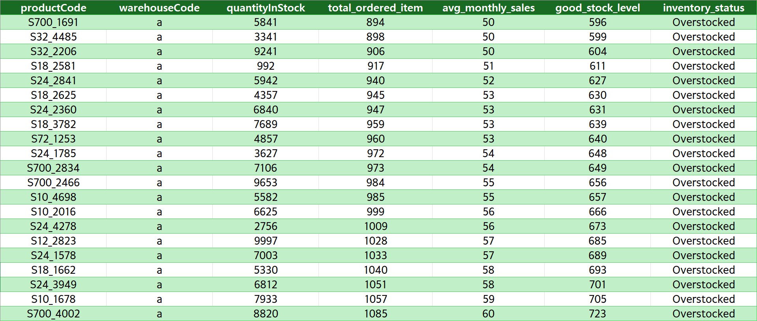
A Warehouse
A warehouse has 21 overstocked Items.

Slide 36
Overstocked B Warehouse
WITH TotalSales AS (
SELECT p.productCode, p.warehouseCode, p.quantityInStock,
COALESCE(SUM(od.quantityOrdered), 0) AS total_ordered_item
FROM mintclassics.products p
LEFT JOIN mintclassics.orderdetails od ON p.productCode = od.productCode
LEFT JOIN mintclassics.orders o ON od.orderNumber = o.orderNumber AND o.status IN ('Shipped', 'Resolved’)
GROUP BY p.productCode, p.warehouseCode, p.quantityInStock
)
SELECT ts.productCode, ts.warehouseCode, ts.quantityInStock, ts.total_ordered_item,
ROUND(ts.total_ordered_item / 18, 0) AS avg_monthly_sales, -- 18-month period for average sales calculation
ROUND((ts.total_ordered_item / 18) * 12, 0) AS good_stock_level, -- Assuming 12 months buffer for good stock level
CASE
WHEN ts.total_ordered_item < 1 OR ts.quantityInStock > (ts.total_ordered_item / 18) * 12 THEN 'Overstocked’
END AS inventory_status
FROM TotalSales ts
WHERE ts.quantityInStock > (ts.total_ordered_item / 18) * 12 AND ts.warehouseCode = ‘b’
ORDER BY ts.warehouseCode, good_stock_level

Slide 37
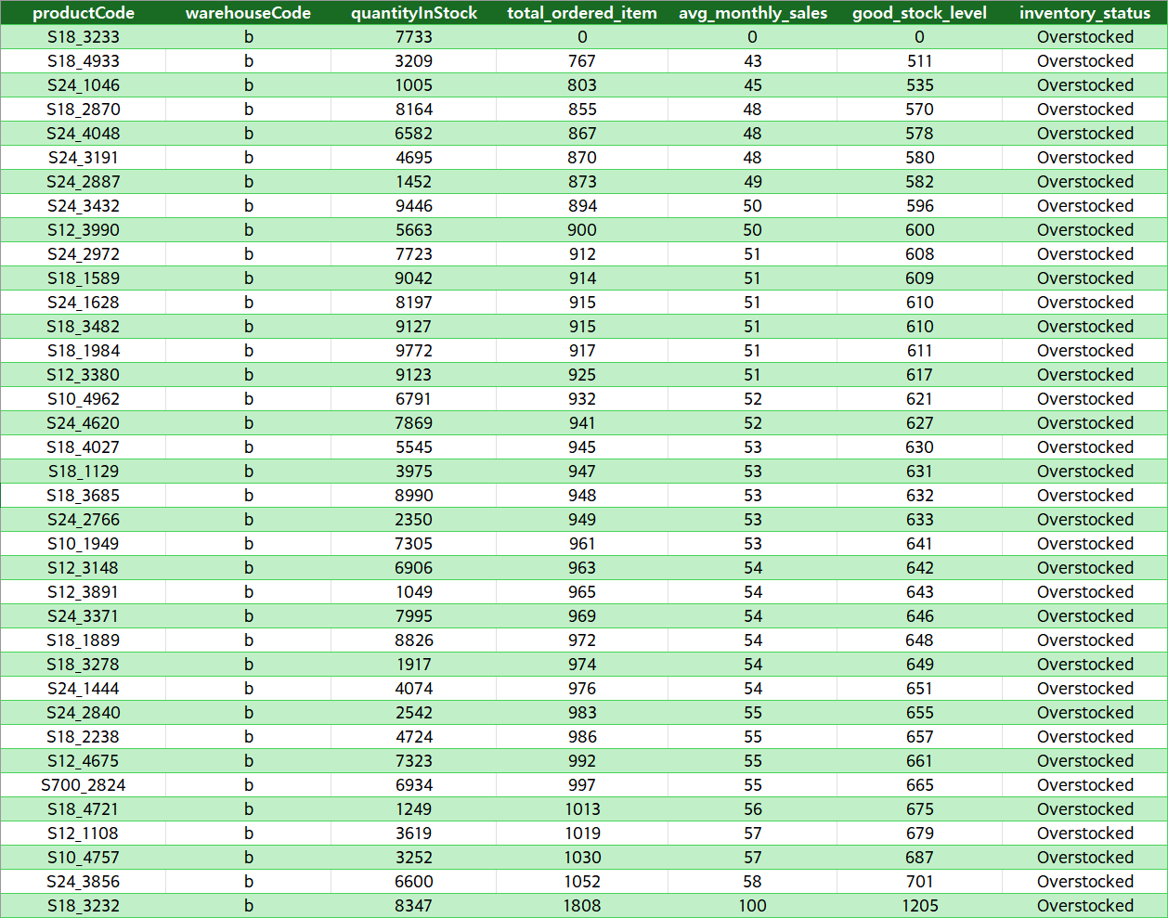
B Warehouse
B warehouse has 37 overstocked Items.

Slide 38
Overstocked C Warehouse
WITH TotalSales AS (
SELECT p.productCode, p.warehouseCode, p.quantityInStock,
COALESCE(SUM(od.quantityOrdered), 0) AS total_ordered_item
FROM mintclassics.products p
LEFT JOIN mintclassics.orderdetails od ON p.productCode = od.productCode
LEFT JOIN mintclassics.orders o ON od.orderNumber = o.orderNumber AND o.status IN ('Shipped', 'Resolved’)
GROUP BY p.productCode, p.warehouseCode, p.quantityInStock
)
SELECT ts.productCode, ts.warehouseCode, ts.quantityInStock, ts.total_ordered_item,
ROUND(ts.total_ordered_item / 18, 0) AS avg_monthly_sales, -- 18-month period for average sales calculation
ROUND((ts.total_ordered_item / 18) * 12, 0) AS good_stock_level, -- Assuming 12 months buffer for good stock level
CASE
WHEN ts.total_ordered_item < 1 OR ts.quantityInStock > (ts.total_ordered_item / 18) * 12 THEN 'Overstocked’
END AS inventory_status
FROM TotalSales ts
WHERE ts.quantityInStock > (ts.total_ordered_item / 18) * 12 AND ts.warehouseCode = ‘c’
ORDER BY ts.warehouseCode, good_stock_level

Slide 39
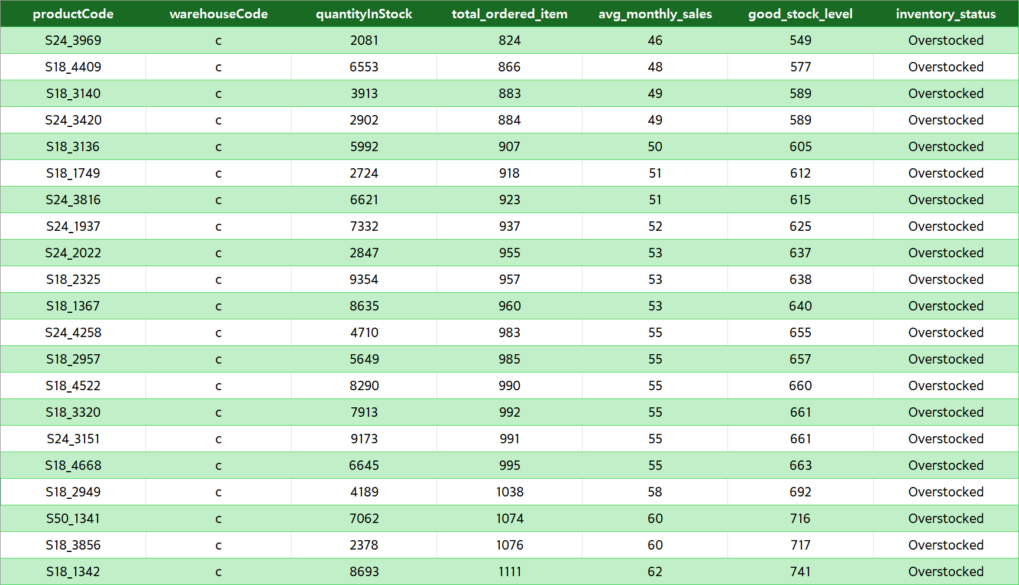
C Warehouse
C warehouse has 21 overstocked Items.

Slide 40
Overstocked D Warehouse
WITH TotalSales AS (
SELECT p.productCode, p.warehouseCode, p.quantityInStock,
COALESCE(SUM(od.quantityOrdered), 0) AS total_ordered_item
FROM mintclassics.products p
LEFT JOIN mintclassics.orderdetails od ON p.productCode = od.productCode
LEFT JOIN mintclassics.orders o ON od.orderNumber = o.orderNumber AND o.status IN ('Shipped', 'Resolved’)
GROUP BY p.productCode, p.warehouseCode, p.quantityInStock
)
SELECT ts.productCode, ts.warehouseCode, ts.quantityInStock, ts.total_ordered_item,
ROUND(ts.total_ordered_item / 18, 0) AS avg_monthly_sales, -- 18-month period for average sales calculation
ROUND((ts.total_ordered_item / 18) * 12, 0) AS good_stock_level, -- Assuming 12 months buffer for good stock level
CASE
WHEN ts.total_ordered_item < 1 OR ts.quantityInStock > (ts.total_ordered_item / 18) * 12 THEN 'Overstocked’
END AS inventory_status
FROM TotalSales ts
WHERE ts.quantityInStock > (ts.total_ordered_item / 18) * 12 AND ts.warehouseCode = ‘d’
ORDER BY ts.warehouseCode, good_stock_level

Slide 41
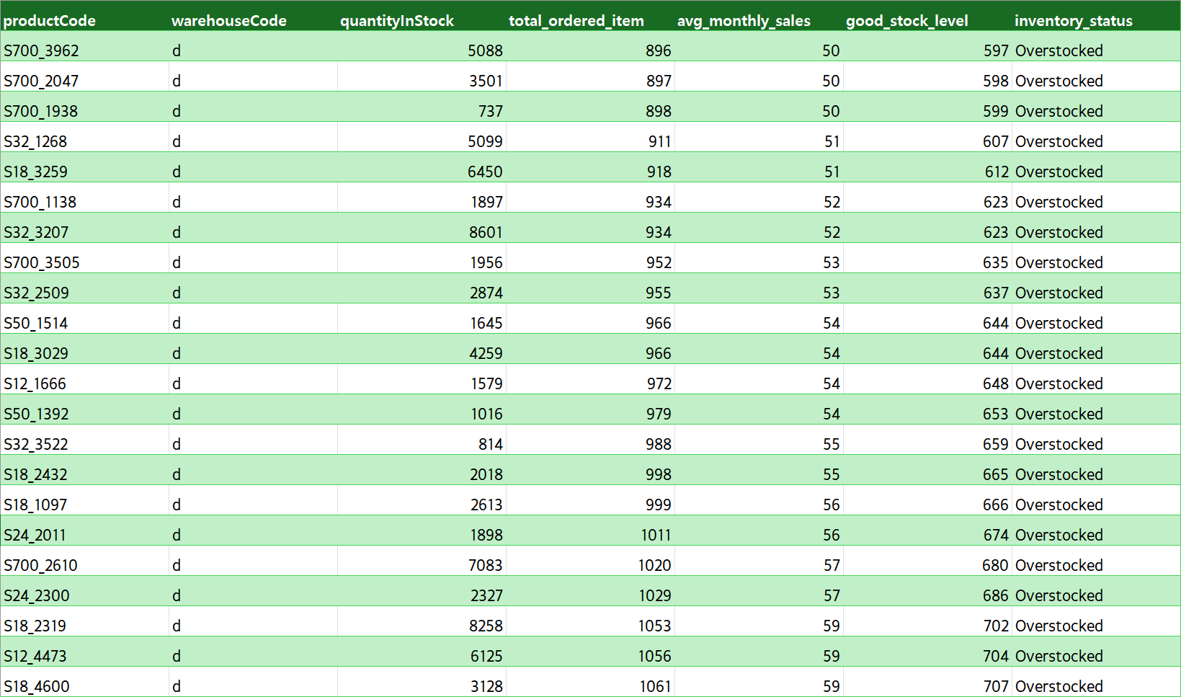
D Warehouse
D warehouse has 22 overstocked Items.

Slide 42
Understocked
WITH TotalSales AS (
SELECT p.productCode, p.warehouseCode, p.quantityInStock,
COALESCE(SUM(od.quantityOrdered), 0) AS total_ordered_item
FROM mintclassics.products p
LEFT JOIN mintclassics.orderdetails od ON p.productCode = od.productCode
LEFT JOIN mintclassics.orders o ON od.orderNumber = o.orderNumber AND o.status IN ('Shipped', 'Resolved’)
GROUP BY p.productCode, p.warehouseCode, p.quantityInStock
)
SELECT ts.productCode, ts.warehouseCode, ts.quantityInStock, ts.total_ordered_item,
ROUND(ts.total_ordered_item / 18, 0) AS avg_monthly_sales, -- 18-month period for average sales calculation
ROUND((ts.total_ordered_item / 18) * 12, 0) AS good_stock_level, -- Assuming 12 months buffer for good stock level
CASE
WHEN ts.quantityInStock < (ts.total_ordered_item / 18) * 12 THEN Understocked’
END AS inventory_status
FROM TotalSales ts
WHERE ts.quantityInStock < (ts.total_ordered_item / 18) * 12
ORDER BY ts.warehouseCode, good_stock_level

Slide 43
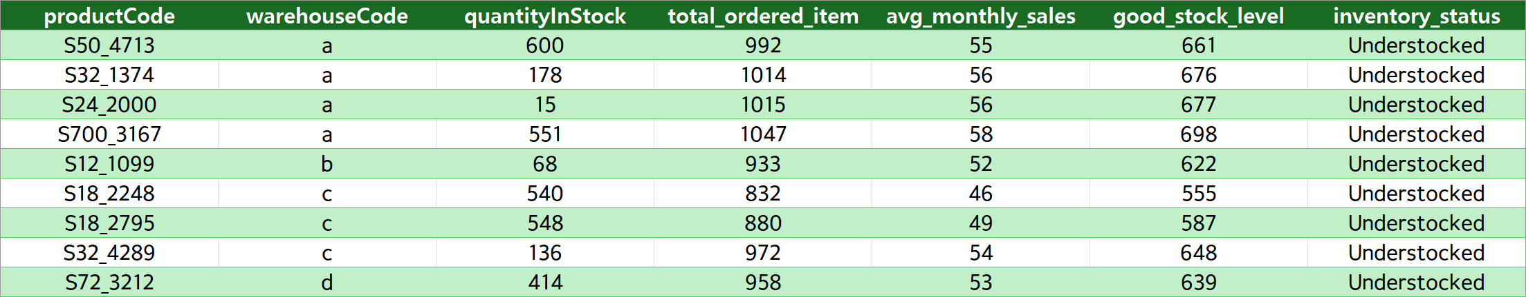
Understocked
9 Items that are understocked in the warehouses 4 of them in A warehouse, 1 in B warehouse, 3 in C warehouse, and 1 in D warehouse.

Slide 44

Actions

Slide 45
Reduce in A Warehouse
WITH TotalSales AS (
SELECT p.productCode, p.productName, p.warehouseCode, p.quantityInStock, p.productScale,
COALESCE(SUM(od.quantityOrdered), 0) AS total_ordered_item,
COALESCE(SUM(od.quantityOrdered * od.priceEach), 0) AS total_revenue
FROM mintclassics.products p
LEFT JOIN mintclassics.orderdetails od ON p.productCode = od.productCode
LEFT JOIN mintclassics.orders o ON od.orderNumber = o.orderNumber AND o.status IN ('Shipped', 'Resolved’)
GROUP BY p.productCode, p.warehouseCode, p.quantityInStock, p.productScale
),
InventoryAnalysis AS (
SELECT ts.productCode, ts.productName, ts.warehouseCode, ts.quantityInStock, ts.total_ordered_item, ts.total_revenue,
ROUND(ts.total_ordered_item / 18, 0) AS avg_monthly_sales,
ROUND((ts.total_ordered_item / 18) * 12, 0) AS good_stock_level_sales,
ROUND(ts.total_revenue / 18, 0) AS avg_monthly_revenue, ts.productScale,
CASE
WHEN ts.total_ordered_item < 1 THEN 'Never ordered’
WHEN ts.quantityInStock > (ts.total_ordered_item / 18) * 12 THEN 'Overstocked’
WHEN ts.quantityInStock < (ts.total_ordered_item / 18) * 12 THEN 'Understocked’
ELSE 'Well-Stocked’
END AS inventory_status
FROM TotalSales ts
)
SELECT ia.productCode, ia.warehouseCode, ia.quantityInStock, ia.total_ordered_item, ia.total_revenue,
ia.avg_monthly_sales, ia.good_stock_level_sales, ia.avg_monthly_revenue, ia.inventory_status,
CASE
WHEN ia.inventory_status = 'Never ordered' OR ia.inventory_status = 'Overstocked' AND
(ia.productScale LIKE '%1:700%' OR ia.productScale LIKE '%1:72%' OR ia.productScale LIKE '%1:50%’
OR ia.productScale LIKE '%1:32%' OR ia.productScale LIKE '%1:24%') THEN 'Reduce’
WHEN ia.inventory_status = 'Understocked' THEN 'Increase’
ELSE 'Maintain’
END AS action
FROM InventoryAnalysis ia
where ia.inventory_status = 'Never ordered' OR ia.inventory_status = 'Overstocked' AND
(ia.productScale LIKE '%1:700%' OR ia.productScale LIKE '%1:72%' OR ia.productScale LIKE '%1:50%’
OR ia.productScale LIKE '%1:32%' OR ia.productScale LIKE '%1:24%’)
HAVING ia.warehouseCode = "a"
ORDER BY ia.warehouseCode

Slide 46
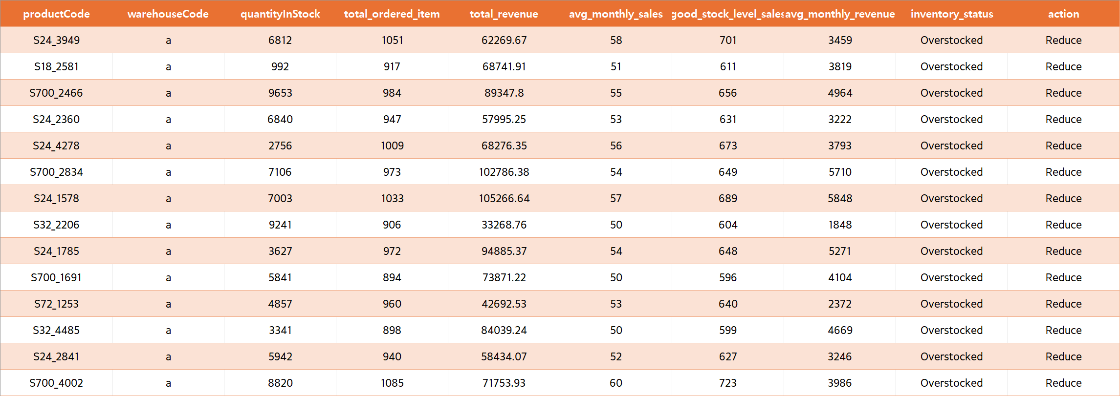
A Warehouse
14 Items should be reduced to Make more space in North warehouse

Slide 47
Reduce in B Warehouse
WITH TotalSales AS (
SELECT p.productCode, p.productName, p.warehouseCode, p.quantityInStock, p.productScale,
COALESCE(SUM(od.quantityOrdered), 0) AS total_ordered_item,
COALESCE(SUM(od.quantityOrdered * od.priceEach), 0) AS total_revenue
FROM mintclassics.products p
LEFT JOIN mintclassics.orderdetails od ON p.productCode = od.productCode
LEFT JOIN mintclassics.orders o ON od.orderNumber = o.orderNumber AND o.status IN ('Shipped', 'Resolved’)
GROUP BY p.productCode, p.warehouseCode, p.quantityInStock, p.productScale
),
InventoryAnalysis AS (
SELECT ts.productCode, ts.productName, ts.warehouseCode, ts.quantityInStock, ts.total_ordered_item, ts.total_revenue,
ROUND(ts.total_ordered_item / 18, 0) AS avg_monthly_sales,
ROUND((ts.total_ordered_item / 18) * 12, 0) AS good_stock_level_sales,
ROUND(ts.total_revenue / 18, 0) AS avg_monthly_revenue, ts.productScale,
CASE
WHEN ts.total_ordered_item < 1 THEN 'Never ordered’
WHEN ts.quantityInStock > (ts.total_ordered_item / 18) * 12 THEN 'Overstocked’
WHEN ts.quantityInStock < (ts.total_ordered_item / 18) * 12 THEN 'Understocked’
ELSE 'Well-Stocked’
END AS inventory_status
FROM TotalSales ts
)
SELECT ia.productCode, ia.warehouseCode, ia.quantityInStock, ia.total_ordered_item, ia.total_revenue,
ia.avg_monthly_sales, ia.good_stock_level_sales, ia.avg_monthly_revenue, ia.inventory_status,
CASE
WHEN ia.inventory_status = 'Never ordered' OR ia.inventory_status = 'Overstocked' AND
(ia.productScale LIKE '%1:700%' OR ia.productScale LIKE '%1:72%' OR ia.productScale LIKE '%1:50%’
OR ia.productScale LIKE '%1:32%' OR ia.productScale LIKE '%1:24%') THEN 'Reduce’
WHEN ia.inventory_status = 'Understocked' THEN 'Increase’
ELSE 'Maintain’
END AS action
FROM InventoryAnalysis ia
where ia.inventory_status = 'Never ordered' OR ia.inventory_status = 'Overstocked' AND
(ia.productScale LIKE '%1:700%' OR ia.productScale LIKE '%1:72%' OR ia.productScale LIKE '%1:50%’
OR ia.productScale LIKE '%1:32%' OR ia.productScale LIKE '%1:24%’)
HAVING ia.warehouseCode = “b"
ORDER BY ia.warehouseCode

Slide 48
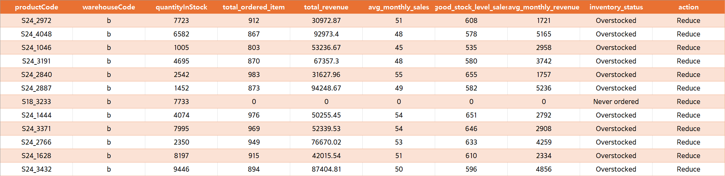
B Warehouse
12 Items should be reduced to Make more space in East warehouse

Slide 49
Reduce in C Warehouse
WITH TotalSales AS (
SELECT p.productCode, p.productName, p.warehouseCode, p.quantityInStock, p.productScale,
COALESCE(SUM(od.quantityOrdered), 0) AS total_ordered_item,
COALESCE(SUM(od.quantityOrdered * od.priceEach), 0) AS total_revenue
FROM mintclassics.products p
LEFT JOIN mintclassics.orderdetails od ON p.productCode = od.productCode
LEFT JOIN mintclassics.orders o ON od.orderNumber = o.orderNumber AND o.status IN ('Shipped', 'Resolved’)
GROUP BY p.productCode, p.warehouseCode, p.quantityInStock, p.productScale
),
InventoryAnalysis AS (
SELECT ts.productCode, ts.productName, ts.warehouseCode, ts.quantityInStock, ts.total_ordered_item, ts.total_revenue,
ROUND(ts.total_ordered_item / 18, 0) AS avg_monthly_sales,
ROUND((ts.total_ordered_item / 18) * 12, 0) AS good_stock_level_sales,
ROUND(ts.total_revenue / 18, 0) AS avg_monthly_revenue, ts.productScale,
CASE
WHEN ts.total_ordered_item < 1 THEN 'Never ordered’
WHEN ts.quantityInStock > (ts.total_ordered_item / 18) * 12 THEN 'Overstocked’
WHEN ts.quantityInStock < (ts.total_ordered_item / 18) * 12 THEN 'Understocked’
ELSE 'Well-Stocked’
END AS inventory_status
FROM TotalSales ts
)
SELECT ia.productCode, ia.warehouseCode, ia.quantityInStock, ia.total_ordered_item, ia.total_revenue,
ia.avg_monthly_sales, ia.good_stock_level_sales, ia.avg_monthly_revenue, ia.inventory_status,
CASE
WHEN ia.inventory_status = 'Never ordered' OR ia.inventory_status = 'Overstocked' AND
(ia.productScale LIKE '%1:700%' OR ia.productScale LIKE '%1:72%' OR ia.productScale LIKE '%1:50%’
OR ia.productScale LIKE '%1:32%' OR ia.productScale LIKE '%1:24%') THEN 'Reduce’
WHEN ia.inventory_status = 'Understocked' THEN 'Increase’
ELSE 'Maintain’
END AS action
FROM InventoryAnalysis ia
where ia.inventory_status = 'Never ordered' OR ia.inventory_status = 'Overstocked' AND
(ia.productScale LIKE '%1:700%' OR ia.productScale LIKE '%1:72%' OR ia.productScale LIKE '%1:50%’
OR ia.productScale LIKE '%1:32%' OR ia.productScale LIKE '%1:24%’)
HAVING ia.warehouseCode = “c"
ORDER BY ia.warehouseCode

Slide 50
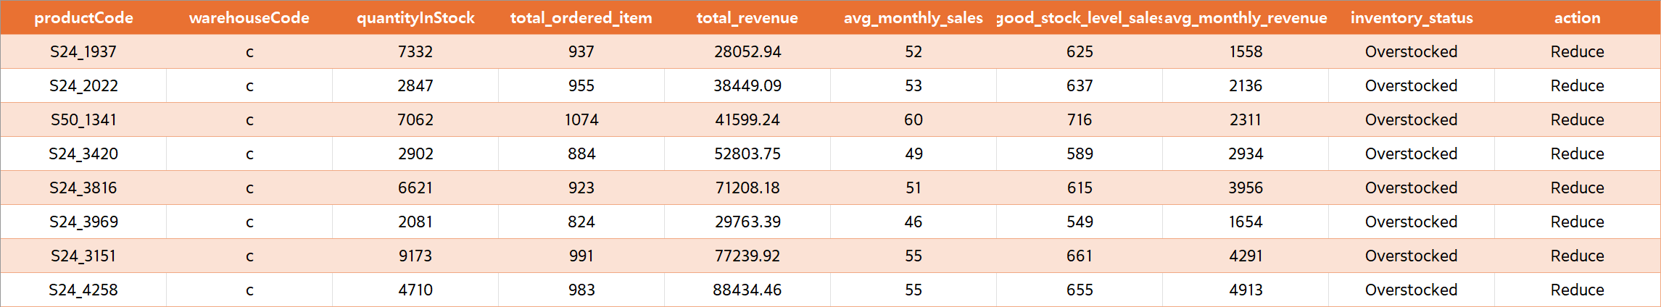
C Warehouse
12 Items should be reduced to Make more space in West warehouse

Slide 51
Reduce in D Warehouse
WITH TotalSales AS (
SELECT p.productCode, p.productName, p.warehouseCode, p.quantityInStock, p.productScale,
COALESCE(SUM(od.quantityOrdered), 0) AS total_ordered_item,
COALESCE(SUM(od.quantityOrdered * od.priceEach), 0) AS total_revenue
FROM mintclassics.products p
LEFT JOIN mintclassics.orderdetails od ON p.productCode = od.productCode
LEFT JOIN mintclassics.orders o ON od.orderNumber = o.orderNumber AND o.status IN ('Shipped', 'Resolved’)
GROUP BY p.productCode, p.warehouseCode, p.quantityInStock, p.productScale
),
InventoryAnalysis AS (
SELECT ts.productCode, ts.productName, ts.warehouseCode, ts.quantityInStock, ts.total_ordered_item, ts.total_revenue,
ROUND(ts.total_ordered_item / 18, 0) AS avg_monthly_sales,
ROUND((ts.total_ordered_item / 18) * 12, 0) AS good_stock_level_sales,
ROUND(ts.total_revenue / 18, 0) AS avg_monthly_revenue, ts.productScale,
CASE
WHEN ts.total_ordered_item < 1 THEN 'Never ordered’
WHEN ts.quantityInStock > (ts.total_ordered_item / 18) * 12 THEN 'Overstocked’
WHEN ts.quantityInStock < (ts.total_ordered_item / 18) * 12 THEN 'Understocked’
ELSE 'Well-Stocked’
END AS inventory_status
FROM TotalSales ts
)
SELECT ia.productCode, ia.warehouseCode, ia.quantityInStock, ia.total_ordered_item, ia.total_revenue,
ia.avg_monthly_sales, ia.good_stock_level_sales, ia.avg_monthly_revenue, ia.inventory_status,
CASE
WHEN ia.inventory_status = 'Never ordered' OR ia.inventory_status = 'Overstocked' AND
(ia.productScale LIKE '%1:700%' OR ia.productScale LIKE '%1:72%' OR ia.productScale LIKE '%1:50%’
OR ia.productScale LIKE '%1:32%' OR ia.productScale LIKE '%1:24%') THEN 'Reduce’
WHEN ia.inventory_status = 'Understocked' THEN 'Increase’
ELSE 'Maintain’
END AS action
FROM InventoryAnalysis ia
where ia.inventory_status = 'Never ordered' OR ia.inventory_status = 'Overstocked' AND
(ia.productScale LIKE '%1:700%' OR ia.productScale LIKE '%1:72%' OR ia.productScale LIKE '%1:50%’
OR ia.productScale LIKE '%1:32%' OR ia.productScale LIKE '%1:24%’)
HAVING ia.warehouseCode = “d"
ORDER BY ia.warehouseCode

Slide 52
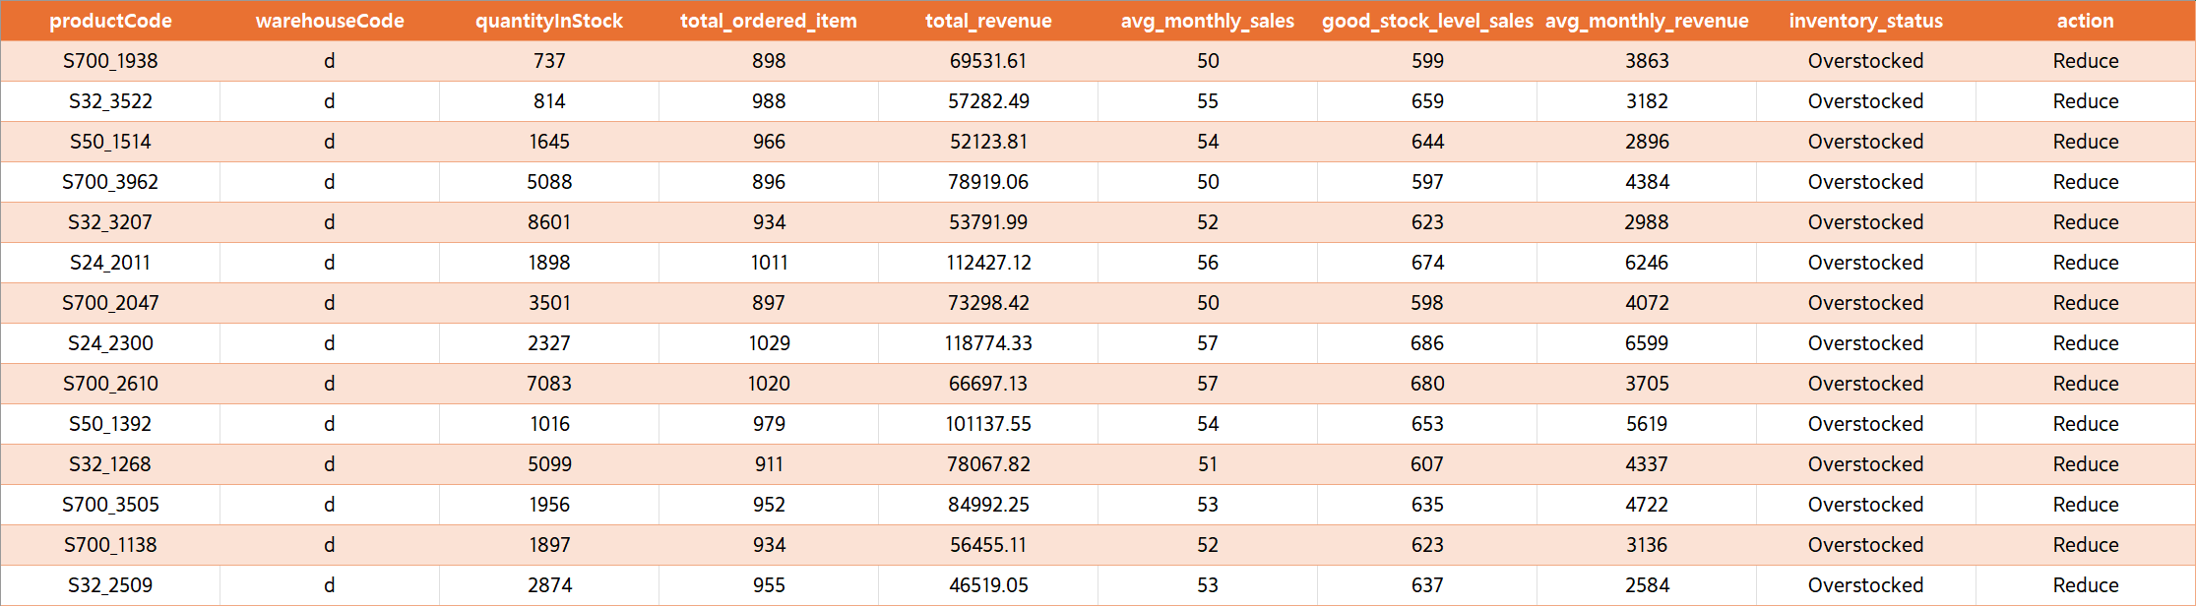
D Warehouse
14 Items should be reduced to Make more space in South warehouse

Slide 53
Increase
WITH TotalSales AS (
SELECT p.productCode, p.productName, p.warehouseCode, p.quantityInStock, p.productScale,
COALESCE(SUM(od.quantityOrdered), 0) AS total_ordered_item,
COALESCE(SUM(od.quantityOrdered * od.priceEach), 0) AS total_revenue
FROM mintclassics.products p
LEFT JOIN mintclassics.orderdetails od ON p.productCode = od.productCode
LEFT JOIN mintclassics.orders o ON od.orderNumber = o.orderNumber AND o.status IN ('Shipped', 'Resolved’)
GROUP BY p.productCode, p.warehouseCode, p.quantityInStock, p.productScale
),
InventoryAnalysis AS (
SELECT ts.productCode, ts.productName, ts.warehouseCode, ts.quantityInStock, ts.total_ordered_item, ts.total_revenue,
ROUND(ts.total_ordered_item / 18, 0) AS avg_monthly_sales,
ROUND((ts.total_ordered_item / 18) * 12, 0) AS good_stock_level_sales,
ROUND(ts.total_revenue / 18, 0) AS avg_monthly_revenue, ts.productScale,
CASE
WHEN ts.total_ordered_item < 1 THEN 'Never ordered’
WHEN ts.quantityInStock > (ts.total_ordered_item / 18) * 12 THEN 'Overstocked’
WHEN ts.quantityInStock < (ts.total_ordered_item / 18) * 12 THEN 'Understocked’
ELSE 'Well-Stocked’
END AS inventory_status
FROM TotalSales ts
)
SELECT ia.productCode, ia.warehouseCode, ia.quantityInStock, ia.total_ordered_item, ia.total_revenue,
ia.avg_monthly_sales, ia.good_stock_level_sales, ia.avg_monthly_revenue, ia.inventory_status,
CASE
WHEN ia.inventory_status = 'Never ordered' OR ia.inventory_status = 'Overstocked' AND
(ia.productScale LIKE '%1:700%' OR ia.productScale LIKE '%1:72%' OR ia.productScale LIKE '%1:50%’
OR ia.productScale LIKE '%1:32%' OR ia.productScale LIKE '%1:24%') THEN 'Reduce’
WHEN ia.inventory_status = 'Understocked' THEN 'Increase’
ELSE 'Maintain’
END AS action
FROM InventoryAnalysis ia
where ia.inventory_status = 'Understocked’
ORDER BY ia.warehouseCode

Slide 54
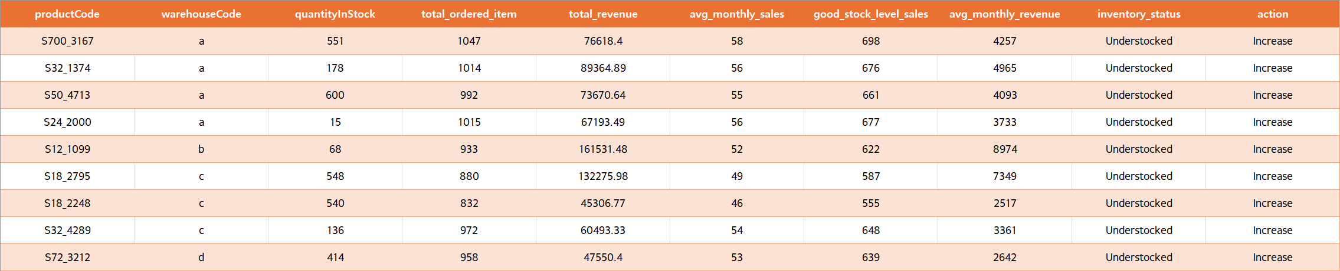
In all warehouses there are 9 products that might Increase.

Slide 55
Maintain
WITH TotalSales AS (
SELECT p.productCode, p.productName, p.warehouseCode, p.quantityInStock, p.productScale,
COALESCE(SUM(od.quantityOrdered), 0) AS total_ordered_item,
COALESCE(SUM(od.quantityOrdered * od.priceEach), 0) AS total_revenue
FROM mintclassics.products p
LEFT JOIN mintclassics.orderdetails od ON p.productCode = od.productCode
LEFT JOIN mintclassics.orders o ON od.orderNumber = o.orderNumber AND o.status IN ('Shipped', 'Resolved’)
GROUP BY p.productCode, p.warehouseCode, p.quantityInStock, p.productScale
),
InventoryAnalysis AS (
SELECT ts.productCode, ts.productName, ts.warehouseCode, ts.quantityInStock, ts.total_ordered_item, ts.total_revenue,
ROUND(ts.total_ordered_item / 18, 0) AS avg_monthly_sales,
ROUND((ts.total_ordered_item / 18) * 12, 0) AS good_stock_level_sales,
ROUND(ts.total_revenue / 18, 0) AS avg_monthly_revenue, ts.productScale,
CASE
WHEN ts.total_ordered_item < 1 THEN 'Never ordered’
WHEN ts.quantityInStock > (ts.total_ordered_item / 18) * 12 THEN 'Overstocked’
WHEN ts.quantityInStock < (ts.total_ordered_item / 18) * 12 THEN 'Understocked’
ELSE 'Well-Stocked’
END AS inventory_status
FROM TotalSales ts
)
SELECT ia.productCode, ia.warehouseCode, ia.quantityInStock, ia.total_ordered_item, ia.total_revenue,
ia.avg_monthly_sales, ia.good_stock_level_sales, ia.avg_monthly_revenue, ia.inventory_status,
CASE
WHEN ia.inventory_status = 'Never ordered' OR ia.inventory_status = 'Overstocked' AND
(ia.productScale LIKE '%1:700%' OR ia.productScale LIKE '%1:72%' OR ia.productScale LIKE '%1:50%’
OR ia.productScale LIKE '%1:32%' OR ia.productScale LIKE '%1:24%') THEN 'Reduce’
WHEN ia.inventory_status = 'Understocked' THEN 'Increase’
ELSE 'Maintain’
END AS action
FROM InventoryAnalysis ia
HAVING action = 'Maintain’
ORDER BY ia.total_ordered_item desc
Limit 10;

Slide 56
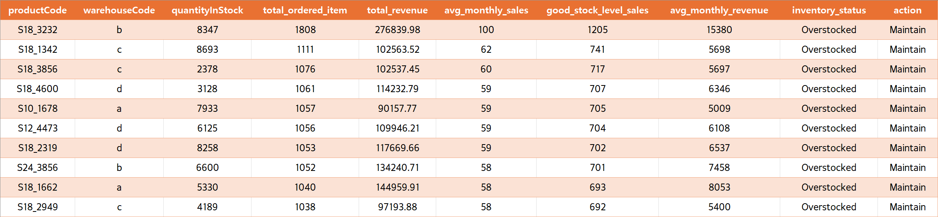
53 Items were found and 10 items are shown.

Slide 57
Founding & Conclusion

